Slide 1




IUL Internal Project
COMPAL 2019 Q2
ChuanLC Wang
Design Leader
Corp. Marketing and Innovation

Slide 2

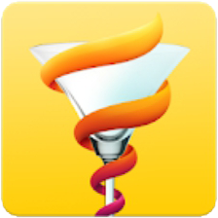

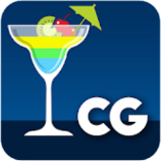
Market
Opportunities
4.5
8,500+ Drink Recipes Free
Download : 5,000,000+
39,133
According to a recently published report by Persistence Market Research, the demand for RTD/high strength premixes is expected to gain a subtle traction in the foreseeable future.The report further estimates that by the end of 2026, a little less than US$ 6 Bn worth of RTD/high strength premixes will be sold globally.
4.3
Cocktail Flow - Drink Recipes
Download : 1,000,000+
17,558
4.6
My Cocktail Bar
Download : 1,000,000+
26,233
4.6
Cocktails Guru (Cocktail)
Download : 100,000+
5,530

Slide 3
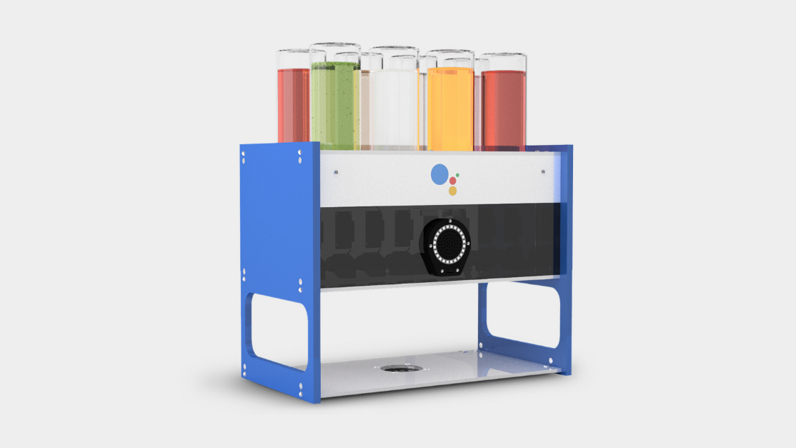
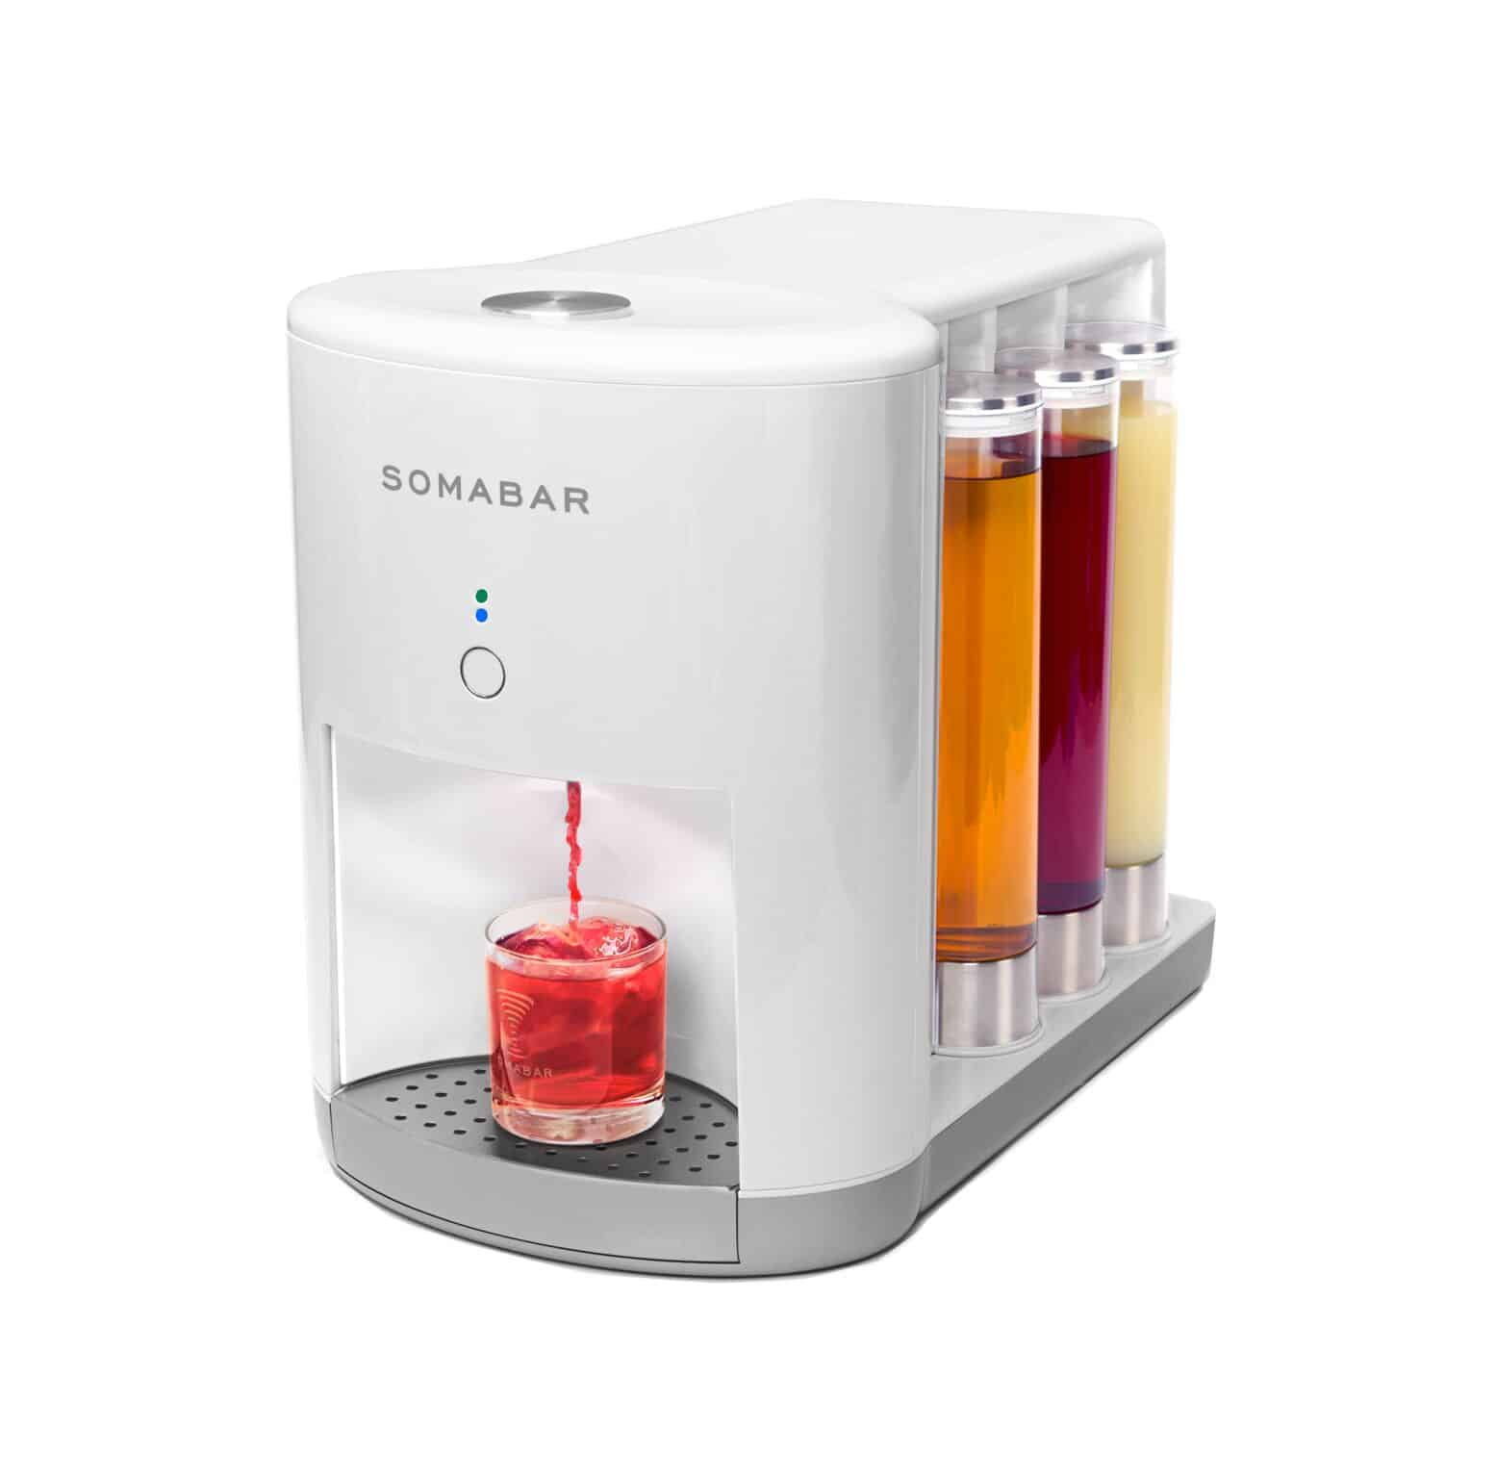
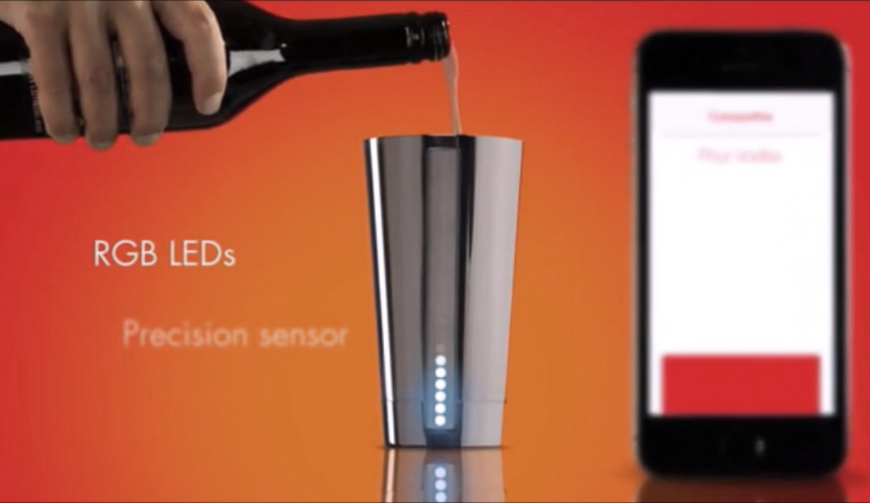
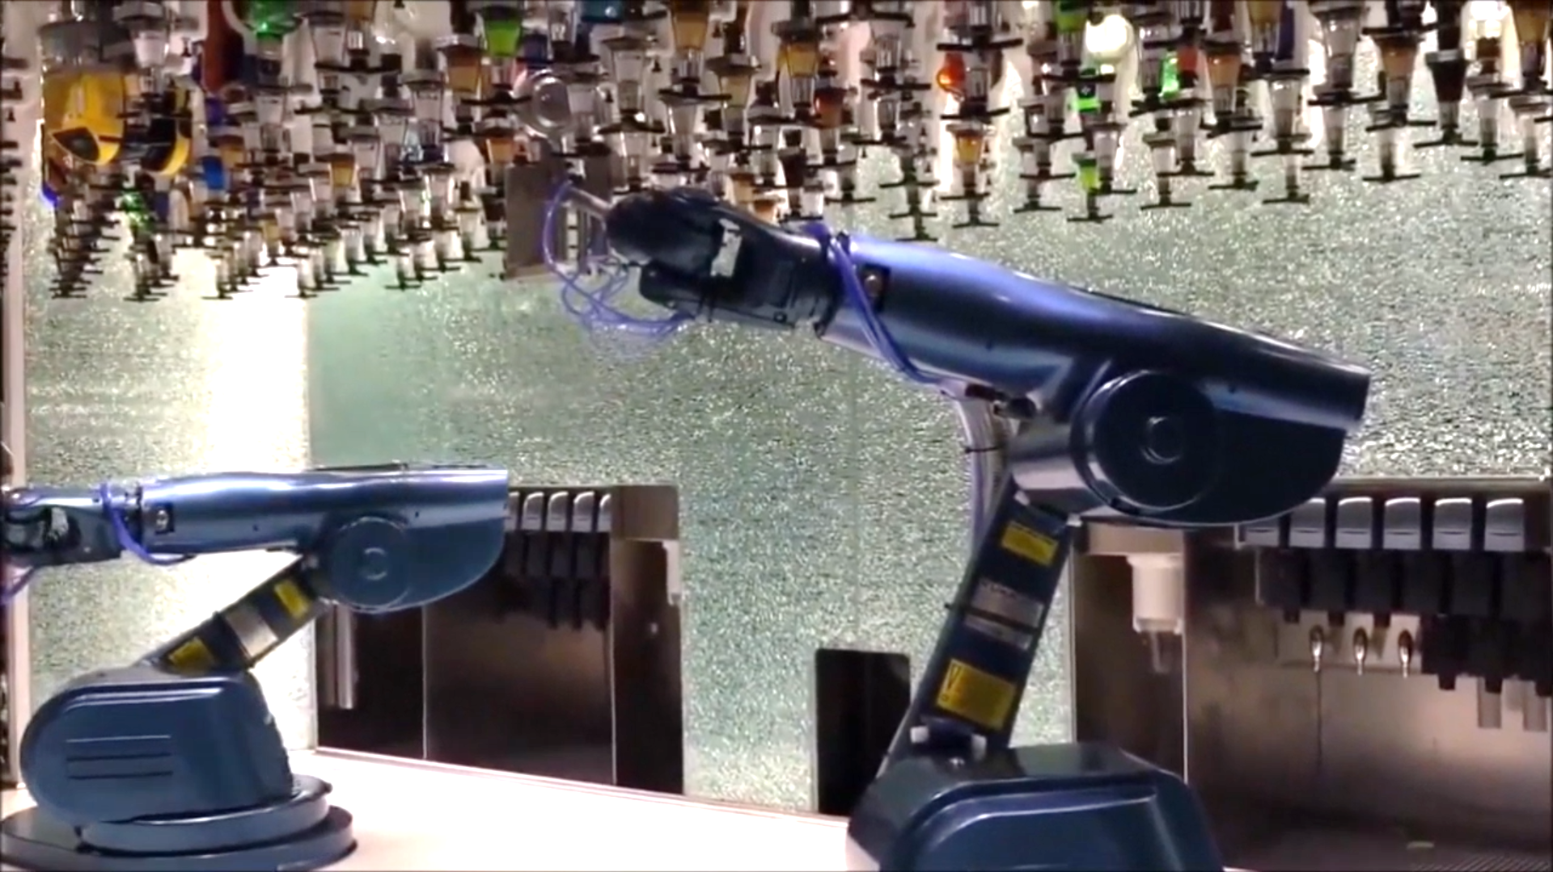
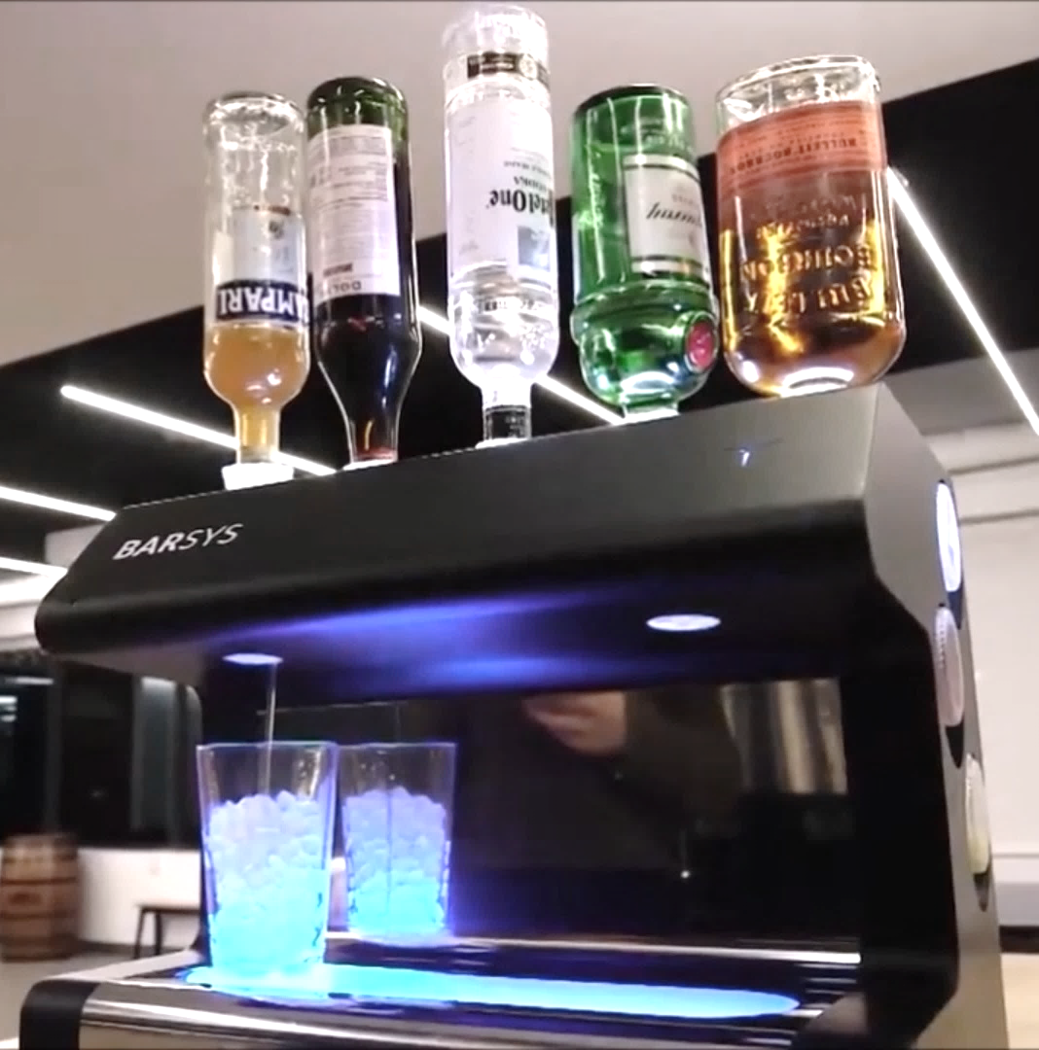

Smart Bartender Product
A new way of interaction with cocktail
Bartending in a easy way
Finding recipes quickly
For Entertainment

Slide 4
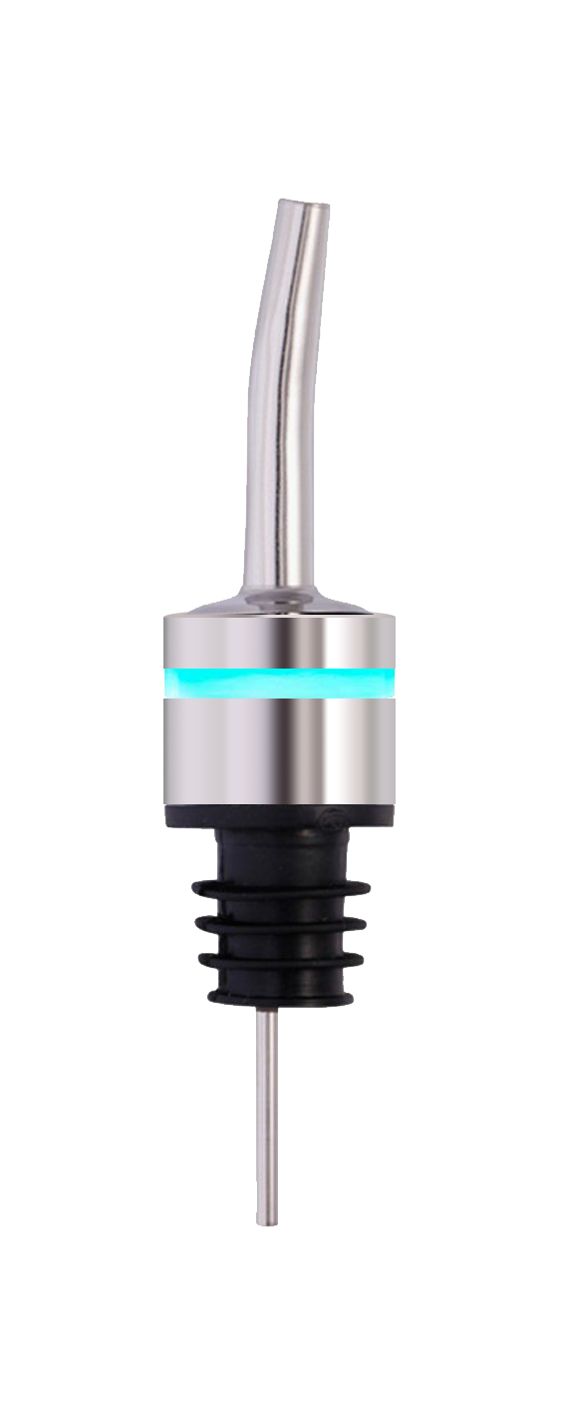
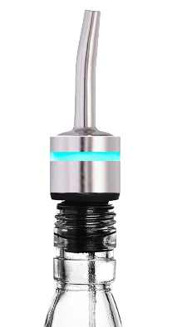

Spout
Stainless steel
portfolio
PCB
What’s with Capit?
MCU
Atmega328p
BLE
BLE 4.2
Connected to multiple caps with one app.
Indicators that show the status of each cap with the perfect portion of a cocktail.
Keep track of each bottle when empty and make recommendation of possible cocktail recipes and spirits.
Indicator
RGB Led Light
Flow Ctrl
Liquid Detection
Tilt Sensor
Normally closed valve (optional)
Battery
Mercury battery
Lithium battery
Rubber Gasket
Different size rings to fit various bottles
Reflowing hole
Reflowing hole for air circulation

Slide 5



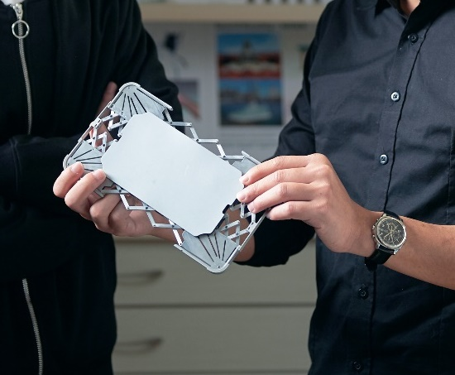


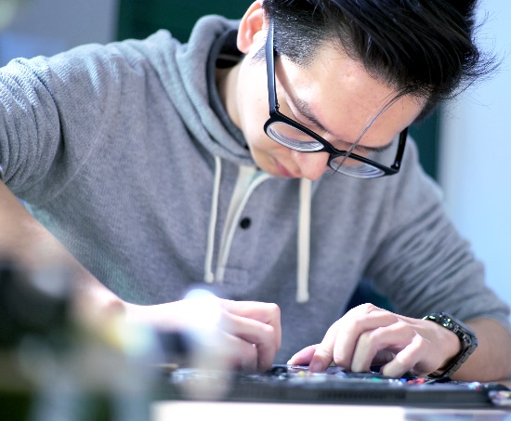
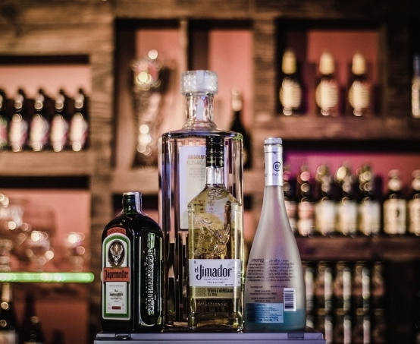
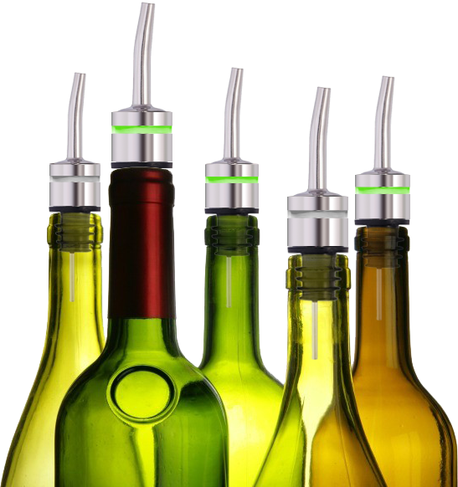


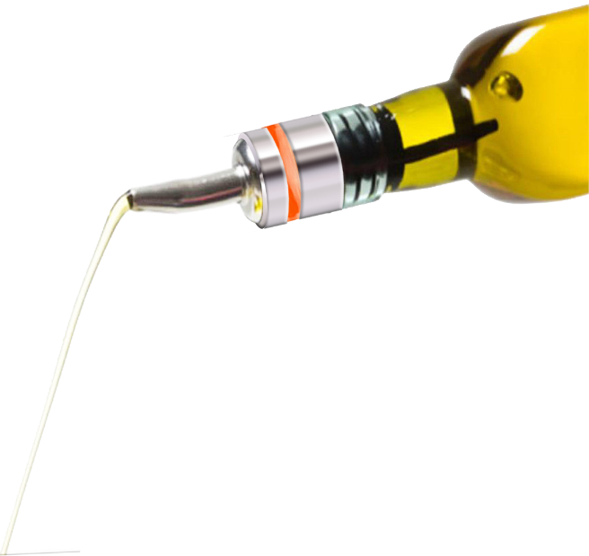
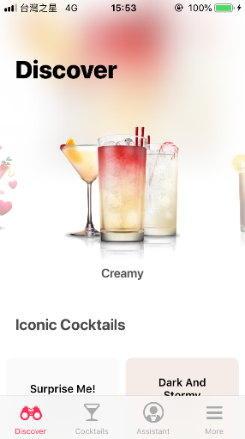
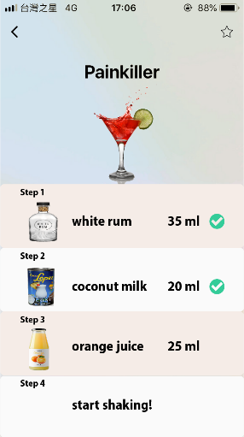
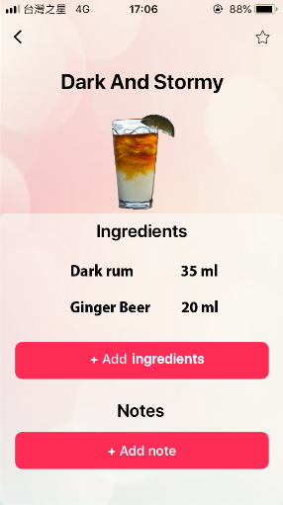
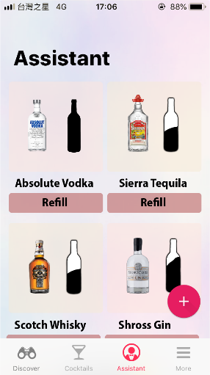


SCENARIO
For beginners that want to be a bartender mixing his own cocktail, Capit is the go-to solution.
With features such as
Finding the right cocktail in just one tap
Mixing drinks with the perfect portion of each ingredient
Managing bottles of spirits
Publishing unique cocktail recipes

Slide 6



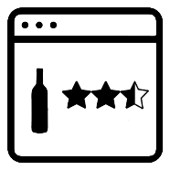


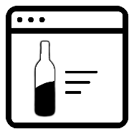

Data Usage
User Behavior
Rank
Submit
User
Preference
Cocktail Info
Cycle
Frequency
Pour
Stock
Cash
Advertising
Vendor

Slide 7
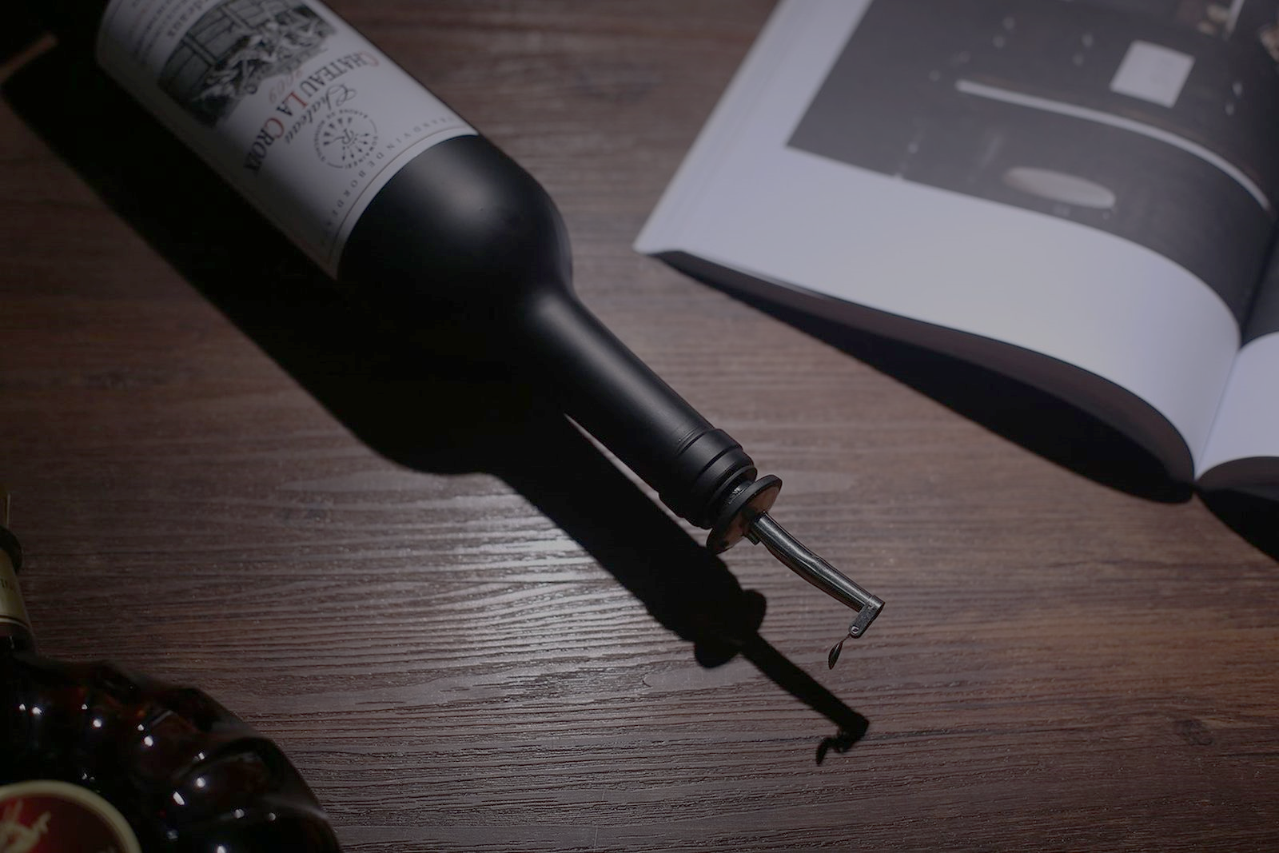
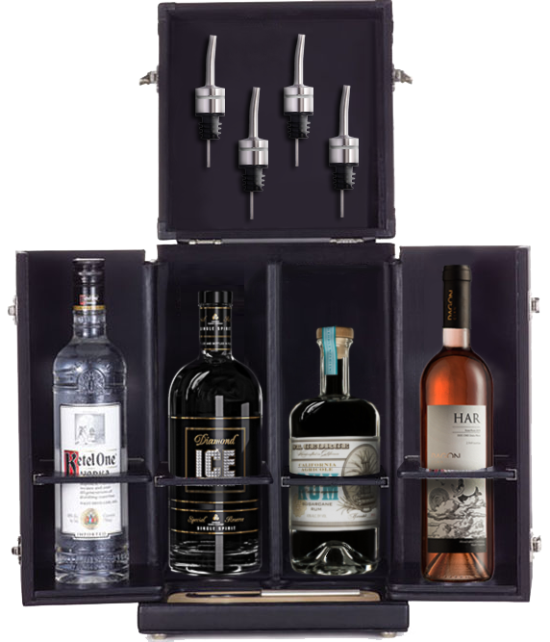
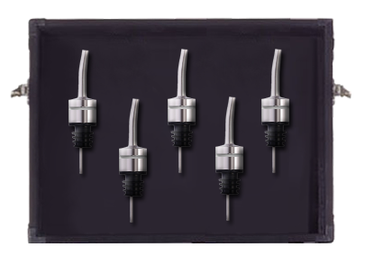
FROM VISION TO REALITY
OUR VISION
For wild ranges of customers, our vision of the product is that it can be sold separately or along with the cocktail spirits.
Caps-only
Deluxe

Slide 8

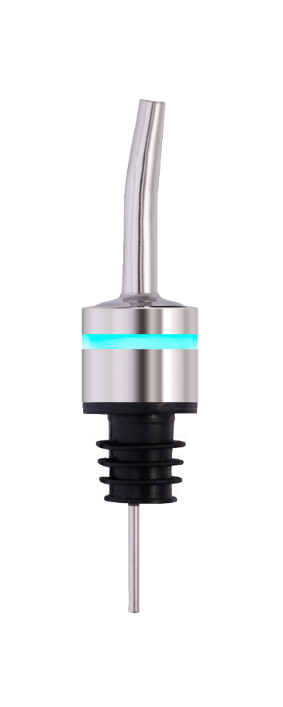


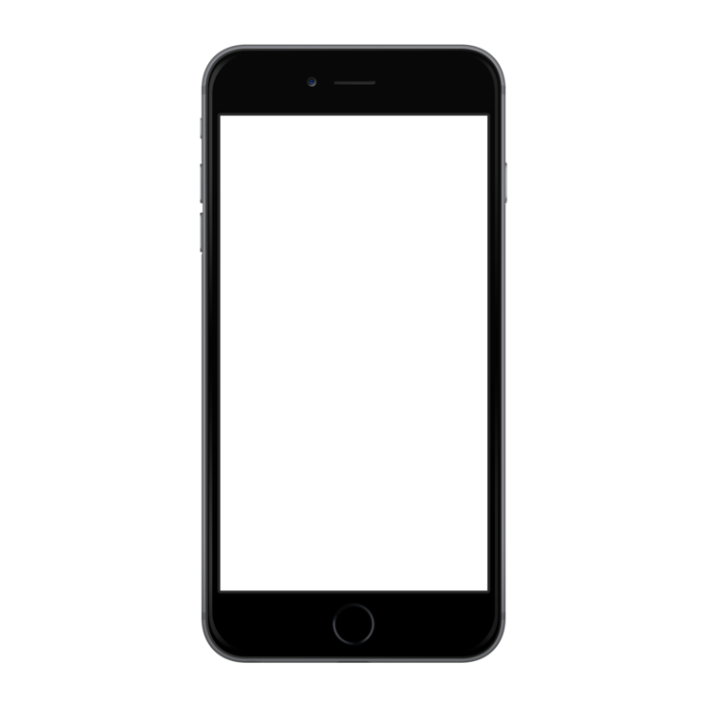
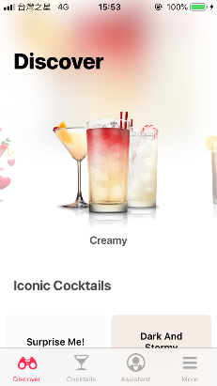
Business Model
Product
Service
Cloud Service
Agents
Consumer
Service
Supply
Shopping
Purchase
Alcohol
e-commerce
Recipe order
Integrated
e-commerce
Journey Map
News & Advertising
Revenue
Alcohol store
Revenue
Cash
Stock
Retail store
Frequency
Vendor
Cash

Slide 9
- HW/SW Integration, Components spec.
- PCB & Layout design
- IP & Product Safety Certification
Feasibility
- Experts in UX & Scenario certification
- Wireframe design
Future Work about CAPIT
UX & Wireframe
- Make arrangements with vendors
- Construct the basis of cloud server
Services & Vendors
- Software dev, Graphic, Form factor
- Marketing survey
- Product testing
Professional Support

Slide 10


10
THANK YOU
Let’s have a drink

Slide 11
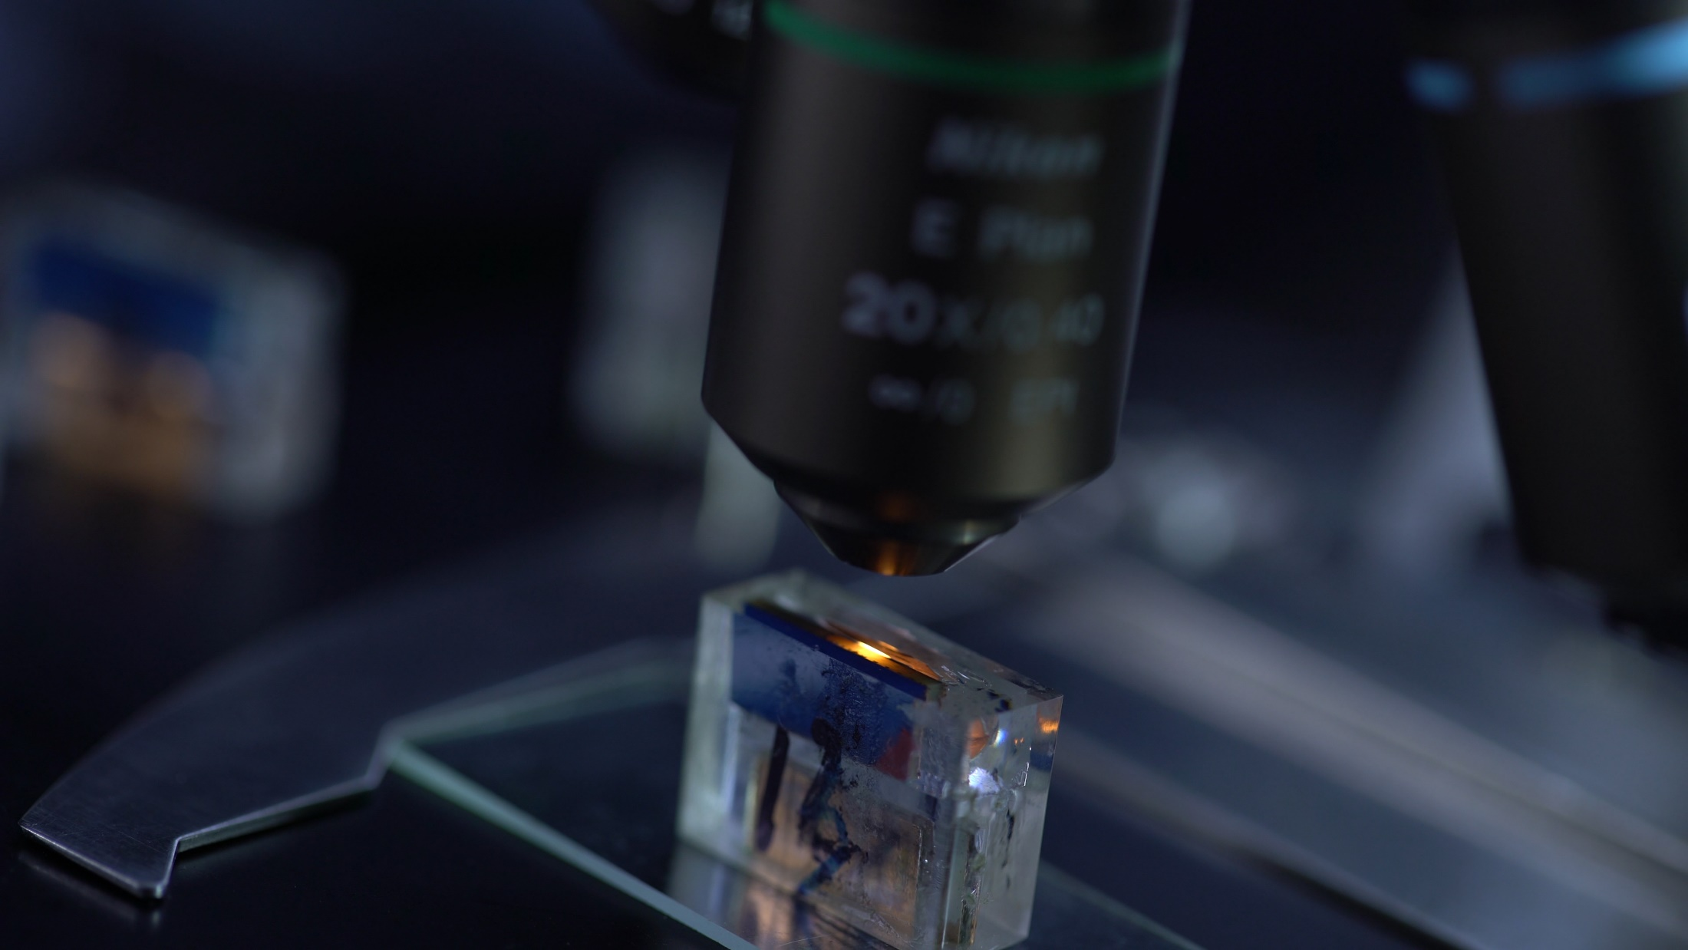
IUL Internal Project
COMPAL New Branding
Round 2
ChuanLC Wang
FROM VISION TO REALITY
Innovation Empowered
Design Leader (Job Title)
Corp. Marketing and Innovation

Slide 12

IUL Internal Project
ChuanLC Wang
Design Leader
Corp. Marketing and Innovation

Slide 13
FROM VISION TO REALITY
OUR VISION
Caps-only
Deluxe

Slide 14
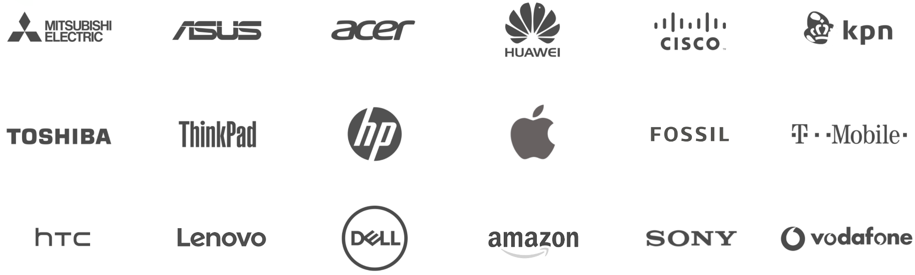
CLIENTS
From Fortune 500s to rising startups, we’ve worked with partners around the world to make products that matter.

Slide 15

TRANSFORMING THE WEARABLE INDUSTRY BY BRIDGING TECHNOLOGY WITH AESTHETICS
As the market for IoT wearable devices expands and evolves, Compal is well positioned as an innovator and trend setter. From Smartwatches to health trackers to Smart Clothing, we are already designing and manufacturing the next generation of wearable technologies. Wearable devices are a form of self-expression that showcase your style to the world. Wearables are technology on-the- go that allow consumers to access information or functions they desire, enhancing their lifestyle and connectivity. Through investment in R&D, partners in our network, and client-centric services, Compal produces high quality wearable devices that shape today’s digital lifestyles.
INVESTMENT IN MARKET RESEARCH PREDICTS NEED AND CREATES DEMAND
Compal believes that market insight can both reflect or shape consumer behavior. Our R&D team proactively gathers and analyzes trends to deliver products that exceed expectations. Whether you are a startup or industry leader in fashion, fitness, healthcare, or technology, we can help you develop wearable devices that fulfill consumers’ need.
WEARABLES
A wearable device is perhaps the most personal of all. At Compal, we have been monitoring the evolution of wearable technology, to understand how the market is changing to meet today's digital lifestyles. Our experience in delivering wearables for some of the top brands means we understand the craftsmanship and detail needed to create a desirable personal device.

Slide 16

THANK YOU
FROM VISION TO REALITY
Innovation Empowered

